Slide 2
Secret Manager

Slide 3

AWS Secrets Manager
AWS Secrets Manager helps you protect secrets needed to access your applications, services, and IT resources.
The service enables you to easily rotate, manage, and retrieve database credentials, API keys, and other secrets throughout their lifecycle.
Users and applications retrieve secrets with a call to Secrets Manager APIs, eliminating the need to hardcode sensitive information in plain text.
Capability to force rotation of secrets every X days.
Automate generation of secrets on rotation (uses Lambda).
Secrets are encrypted using KMS.

Slide 4
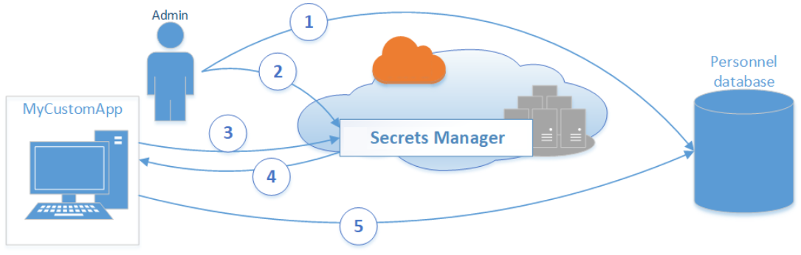
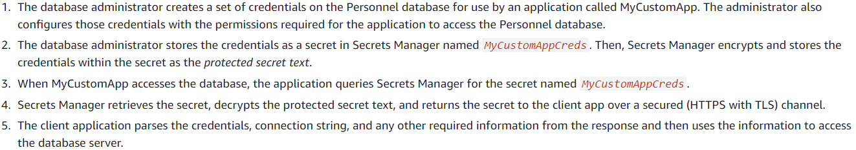
Basic AWS Secrets Manager scenario
The following diagram illustrates the most basic scenario. The diagram displays you can store credentials for a database in Secrets Manager, and then use those credentials in an application to access the database.

Slide 5
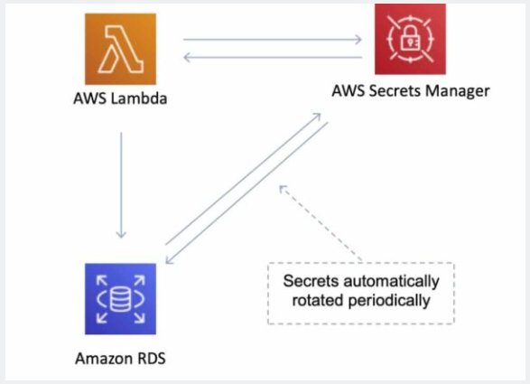
AWS Secrets Manager - rotation
You can extend Secrets Manager to rotate other secrets by modifying sample Lambda functions.
You can store and retrieve secrets using the AWS Secrets Manager console, AWS SDK, AWS CLI, or AWS CloudFormation.
AWS Secrets Manager enables you to audit and monitor secrets through integration with AWS logging, monitoring, and notification services.

Slide 6
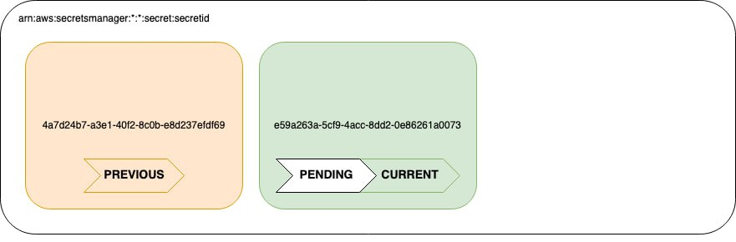
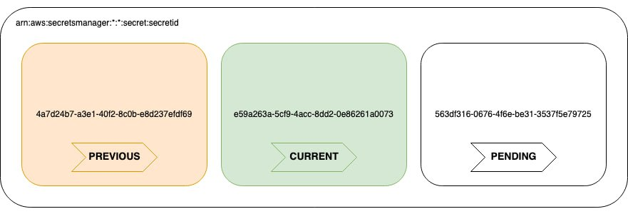
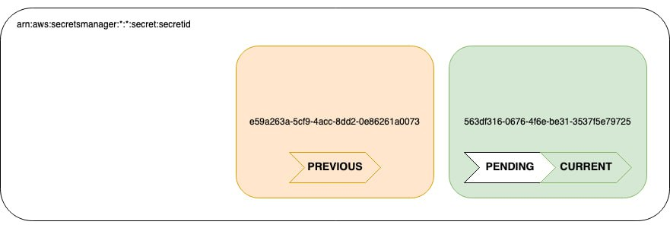
Secrets Manager Rotation
Rotation is the process of periodically updating a secret. When you rotate a secret, you update the credentials in both the secret and the database or service. In Secrets Manager, you can set up automatic rotation for your secrets.

Slide 7

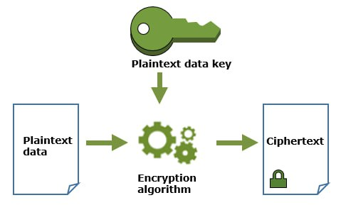
Secrets Manager Encryption
Secrets Manager & KMS:
Secrets Manager uses encryption via AWS KMS
Every secret in Secrets Manager is encrypted with a unique data key.
You can choose to use default encryption with the Secrets Manager AWS managed key for the account
You can create your own customer managed key in AWS KMS.
Using a customer managed key gives you more granular authorization controls over your KMS key activities
When Secrets Manager needs to encrypt a new version of the protected secret data:
Secrets Manager sends a request to AWS KMS to generate a new data key from the KMS key
Secrets Manager uses this data key for envelope encryption.
Secrets Manager stores the encrypted data key with the encrypted secret.

Slide 8
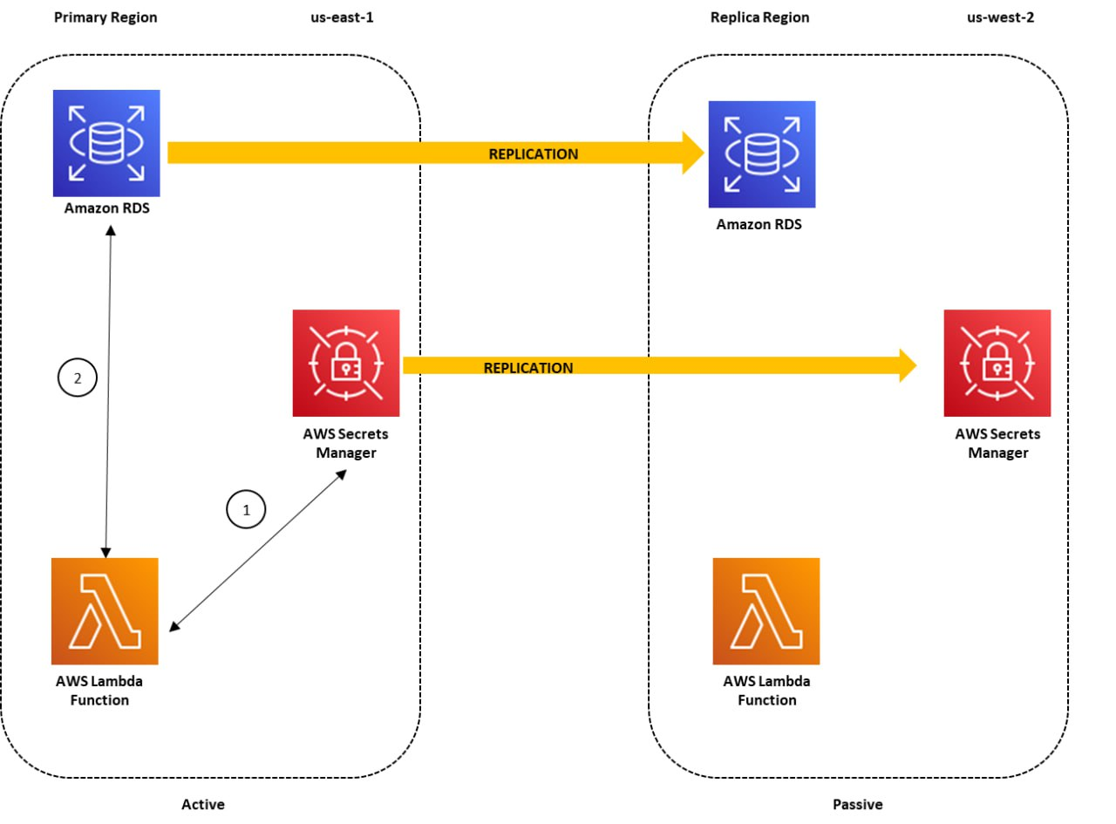
Secrets Manager Replication
With replication feature, you can create Regional read replicas for your secrets.
When you create a new secret or edit an existing secret, you can specify the Regions where your secrets need to be replicated.
Secrets Manager will securely create the read replicas for each secret and its associated metadata, eliminating the need to maintain a complex solution for this functionality.
Any update made to the primary secret, such as a secret value updated through automatic rotation, will be automatically propagated by Secrets Manager to the replica secrets, making it easier to manage the life cycle of multi-Region secrets.

